Slide 1
Software Testing
Code-Based Data Flow Testing
Presented By
Ning Chen, Ph.D.
Professor
Department of Computer
Science
California State University,
Fullerton
© Ning Chen, 2017
*

Slide 2
Module Objectives
This module focuses on the Code-Based Data Flow Testing

Slide 3
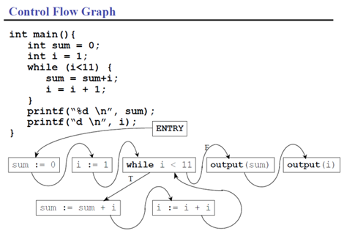
Control Flow Graph

Slide 4
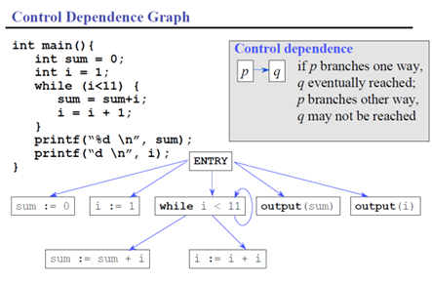
Control Dependence Graph
From the Control Flow Graph one can come up with the Control Dependence Graph as follows:

Slide 5
Rules
We use the following rules to form the Control Dependence Graph. Notice that here we call a node as a vertex. A Program Dependence Graph of a program P contains a Control Dependence edge from vertex v1 to vertex if and only if one of the following holds:
  Vertex v1 is the entry vertex and v2 represents a component of program P that is not nested within a loop or conditional;
  Vertex v1 represents a control dependence and v2 represents a component of P immediately nested within a loop or a conditional statement whose predicate is represented by v1. If v1 is a test predicate of a loop structure the edge is labeled True.

Slide 6
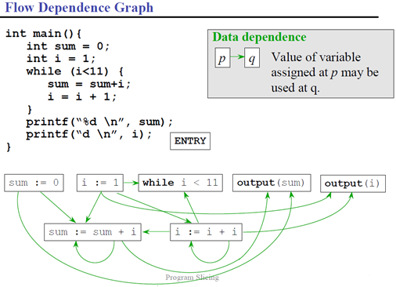
Data (flow) Dependence Graph

Slide 7
Rules
We also obtain the Flow Dependence Graph (also called Data Dependence Graph) by the following mechanism:
A Program Dependence Graph of a program P contains a Data Dependence edge from vertex v1 to vertex v2 if and only if all of the following holds:
  Vertex v1 is a vertex that defines variable x
  Vertex v2 is a vertex that uses variable x (or x’s aliases)
  Control can reach v2 after v1, via an execution path along which there is no other intervening definition of x. That is there is a path in the program’s CFG by which definition of x at v1 reaches the use of x at v2.

Slide 8
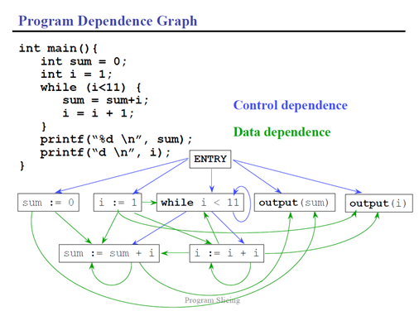
Overlapping Two Graphs

Slide 9
Backward Slicing (Step 1)
Once we have obtained both graphs, we may begin our backward slicing. For our example, our slicing criterion is the variable i and at the line printf(“d \n”, i). Once this criterion is determined, we work backward starting from the line location printf(“d\d”, i) or for convenience, we label this line as Output (i).

Slide 10
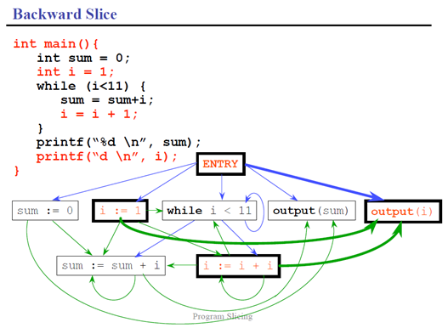
Backward Slicing

Slide 11
Step 2
As we work backward in the first step, we notice that there are several vertexes (nodes) that reach the vertex/node Output(i) with just one incoming edge either as control dependence or data dependence edge. In the above graph, those edges are highlighted. As the second step, we now shift our attention to the new vertexes connected by the highlighted edges (and they are Entry, i :=1, i :=i+1). Again, we highlight the incoming edges to those three vertexes/nodes. This resulting graph is shown below.

Slide 12
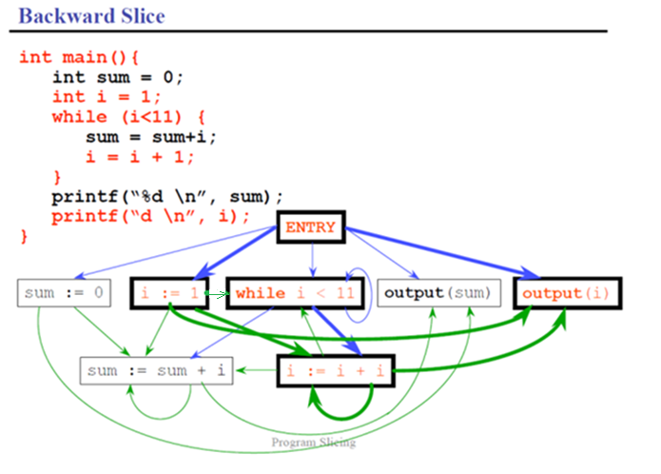
Backward Slicing

Slide 13
Step 3
As the third step in our example, the new vertex/node in this step is while i < 11. Note that after highlighting its incoming edges, we reach no new vertexes/nodes.

Slide 14
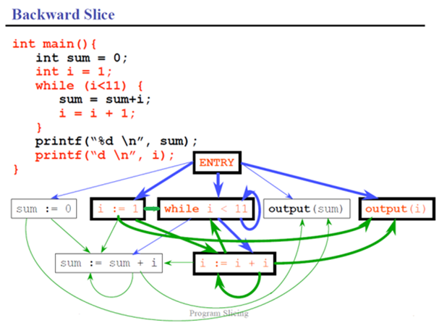
Backward Slicing

Slide 15
Finally
At this point, we stop and take out all untouched vertexes and edges. We end up with the following graph and therefore, the slice of the program based on the criterion (variable i, at line printf(“d \n”, i)) as shown below.

Slide 16
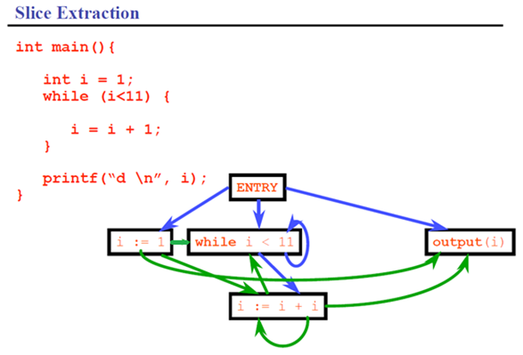
Result

Slide 17
Another Example
The above analysis is restricted within one single function/procedure and is called Intraprocedural Slicing. If more than one procedure is involved, we need to perform Interprocedural Slicing.

Slide 18
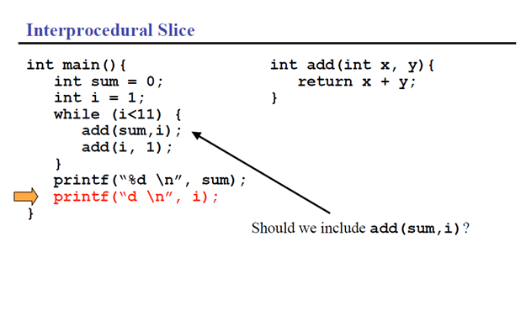
Interprocedure Slice

Slide 19
Continued
In this example, we have two procedures. One is the main procedure and the other is the procedure add (sum, i). Also, we still use the same slicing criterion of (variable i, printf(“d \n”, i)).

Slide 20
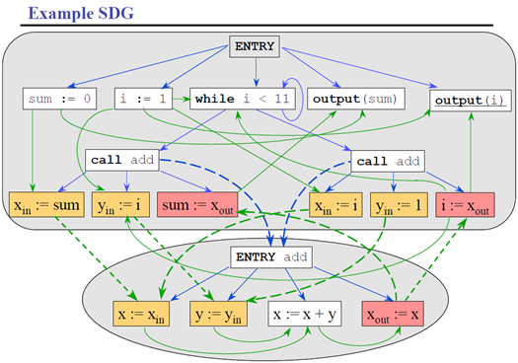
Step 1

Slide 21
Abstraction
Its “zoom-out” or “abstracted” version is shown below.

Slide 22
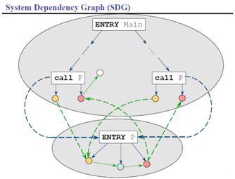
Abstraction

Slide 23
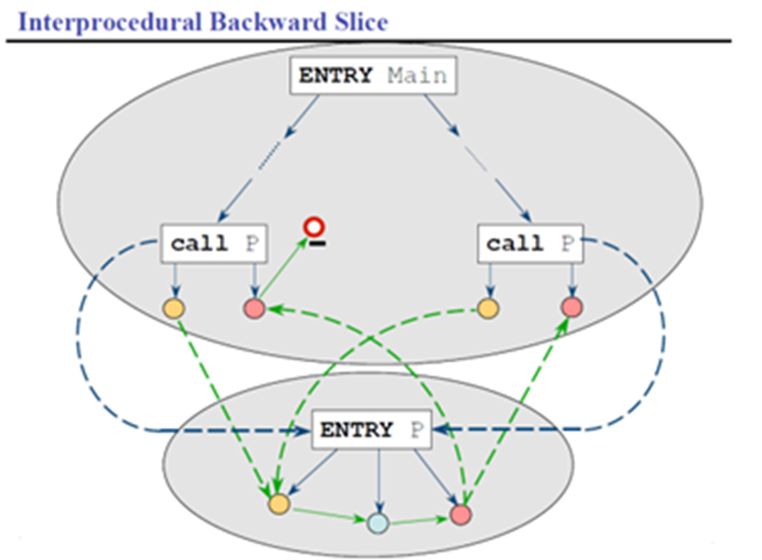
Step 1 (starting again)
Again, as the first step, we start the targeted line print (“d \n”, i) also called Output (i) in our graph and we work our way backward.

Slide 24
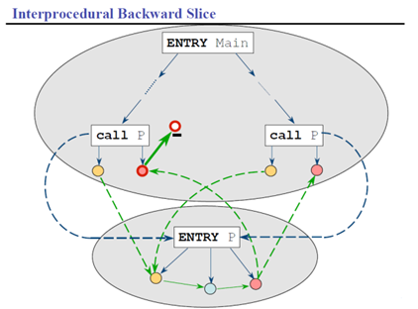
Step 2

Slide 25
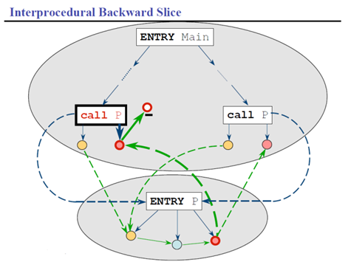
Step 3

Slide 26
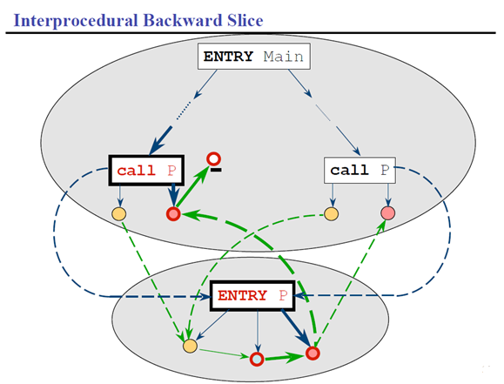
Step 4

Slide 27
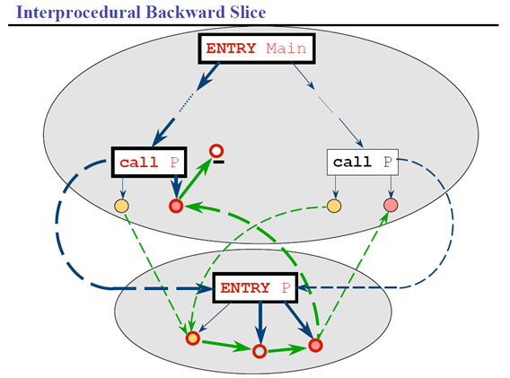
Step 5

Slide 28
Note:
It is important to note the extra rule we create here. The ENTRY P actually can be tracked back to two “call P” boxes. Nevertheless, we don’t want to highlight both of the dashed incoming edges that link two “call P” boxes to the “ENTRY P” box. The reason is that only one of the “call P” boxes actually calls the “ENTRY P” box. Which “call P” box is the one that actually calls the “ENTRY P” box? The answer is the highlighted one. Therefore, we should only highlight the edge from an already highlighted “call P” box to the “ENTRY P” box.

Slide 29
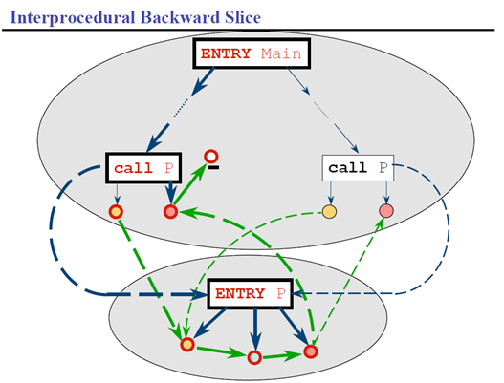
Step 6

Slide 30
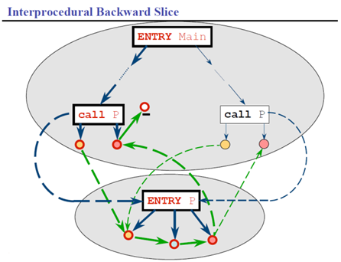
Step 7

Slide 31
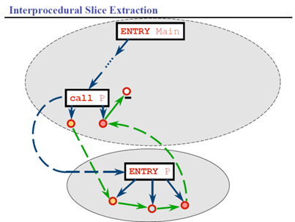
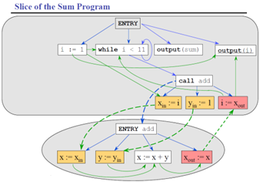
Finally

Slide 32
Final Result
From the final graph, we now have our slice as follows:
int main() {
int i=1;
while (i<11) {
add (I, 1);
printf(“%d \n”, i);
}
int add(int x, y) {
Return x+y;
}

